Slide 1
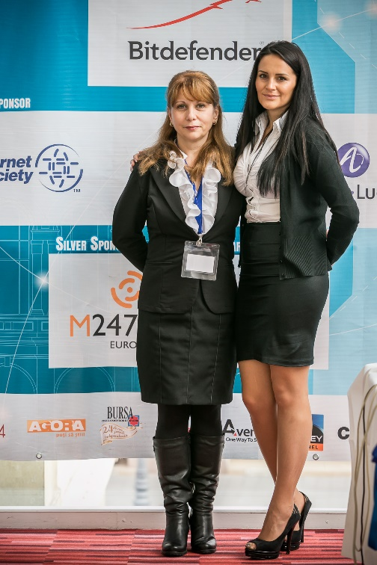
RONOG2 - Introduction
Interlan & The operators’ community

Slide 2
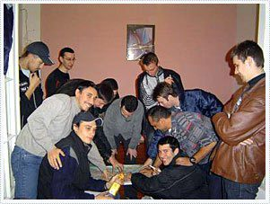
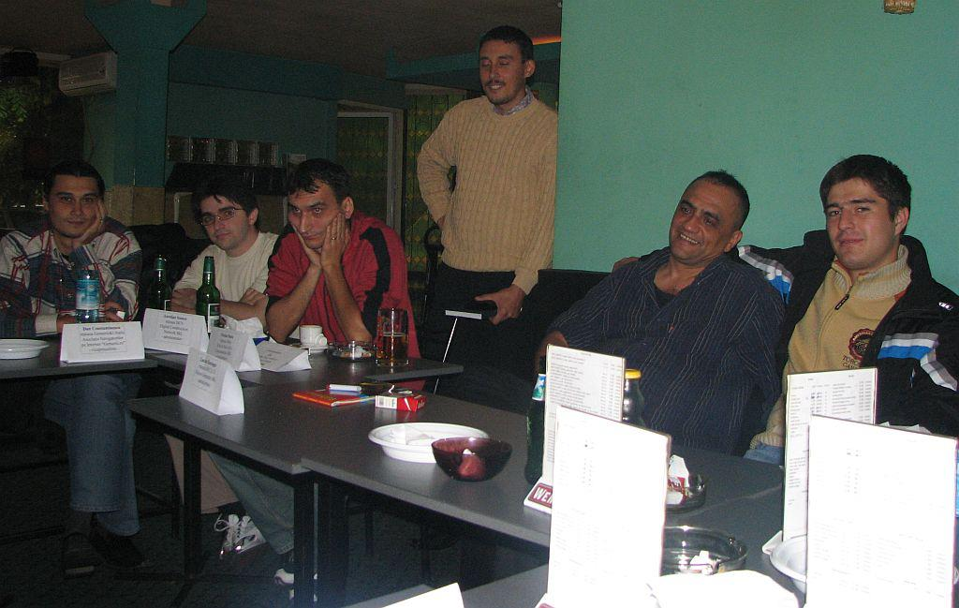
The Internet & The neighborhood networks
1994 – First dial-up connections are available
1997 – First Internet Café’s with leased lines
1998 – LAN Parties & first Local Area Networks between neighbors
INTERconnecting Local Area Networks
2000 – The first permanent internet connections are available through the local area networks
2002 – The first neighborhood networks with over 1,000 users
2003 – Optical Fiber connections with internet providers
2004 – The networks met each other and decided to interconnect

Slide 3
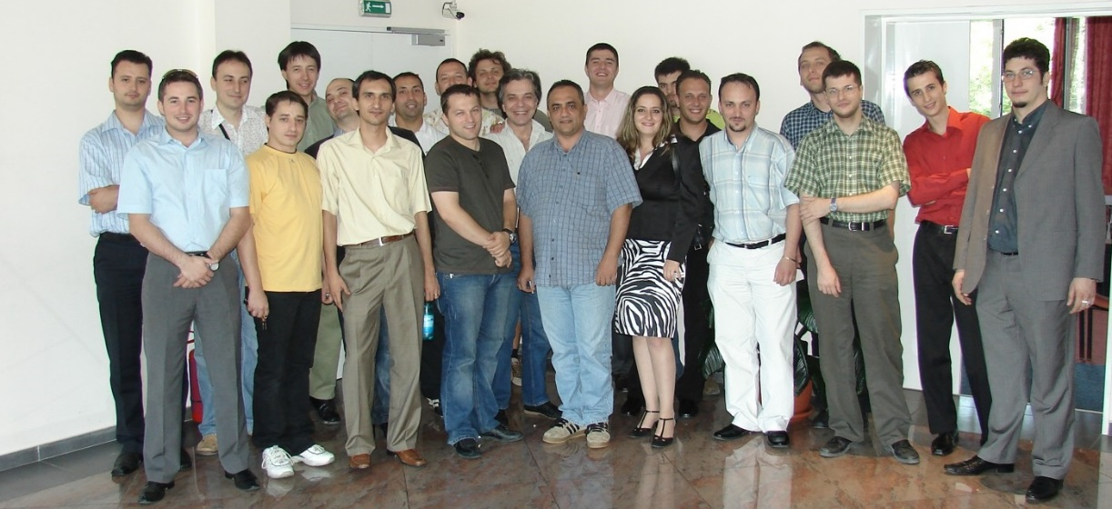
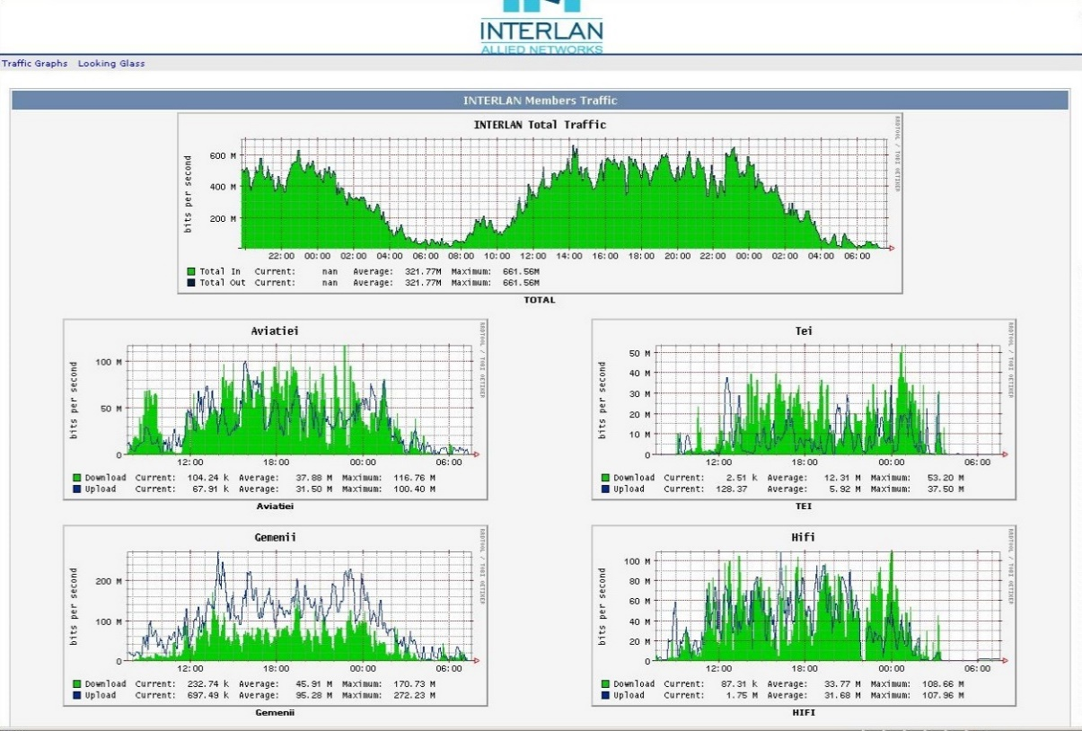
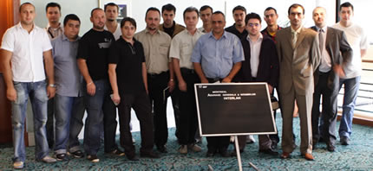
Founding of Interlan & the Internet Exchange
2005 – The Neighborhood Networks decided to establish an organization which will operate the Internet Exchange
2008 – Interlan become a member of Euro-IX and started to attend RIPE Meetings, EIX Working Group

Slide 4
First Steps
On November 12th, 2012, at the 23th Euro-IX Forum in Stockholm, Sweden, Interlan presents a small material about IXP’s in Romania.
On April 15, 2013 at the 24th Euro-IX Forum in Hamburg, Germany, Interlan officially presents the Romanian dubbed version of the Euro-IX film, "Internet Revealed“.

Slide 5
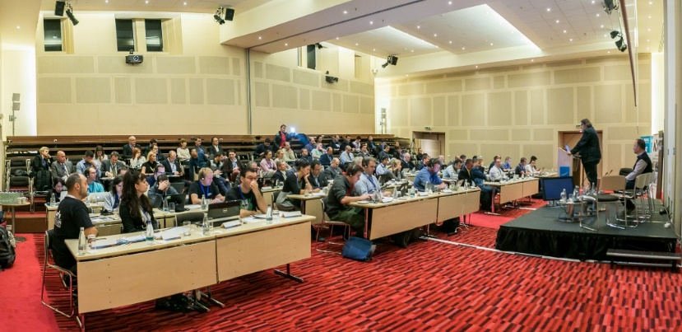
The first Euro-IX Forum in Romania & The first RONOG
October 28, 2013 - 25th Euro-IX Forum in Helsinki, Finland: Interlan invites Euro-IX to organize a Forum in Bucharest and initiate discussions in this regard.
March 17, 2014 - 26th Euro-IX Forum in Leeds, UK: Interlan is officially announced as the host of the next Forum. The participants asked Interlan to meet local operators after the Forum.
27 October 2014 - The 27th Euro-IX Forum in Bucharest: Interlan Euro-IX hosts the first Forum in Romania. It also win a seat in the board of the organization
October 29, 2014 - First RONOG edition with the support of Euro-IX, RIPE NCC and Internet Society (ISOC).

Slide 6
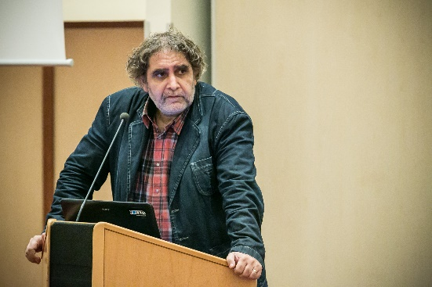
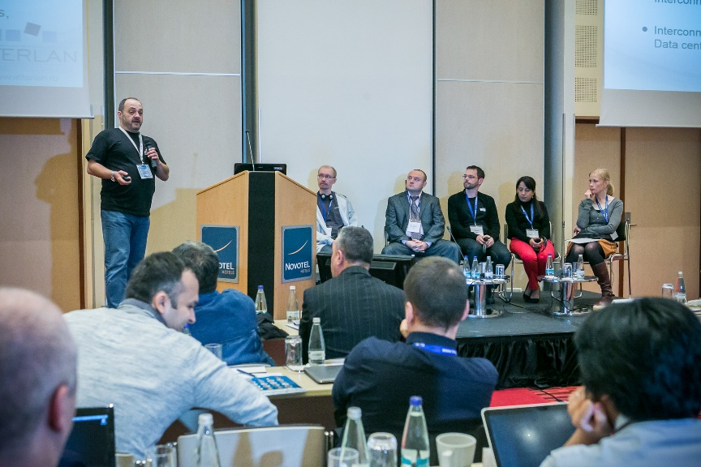
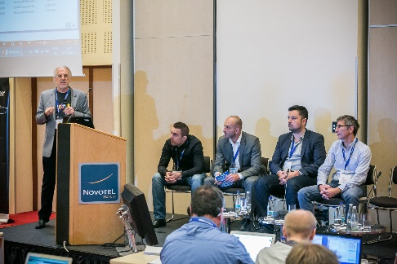
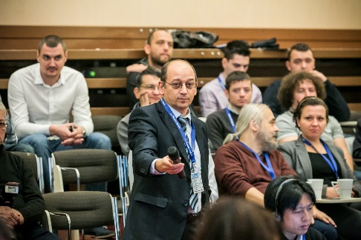
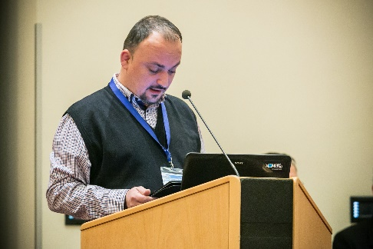
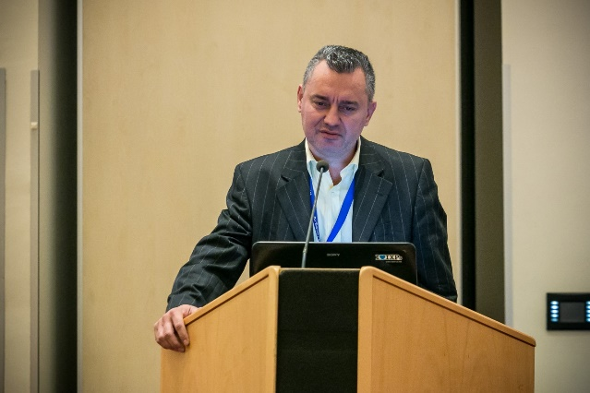
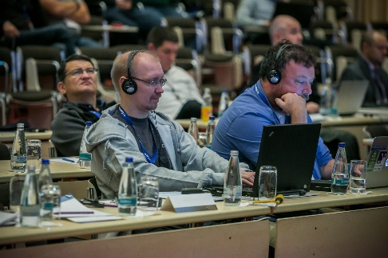
First RONOG edition: October 29, 2014

Slide 7
Relationship with RIPE NCC and bringing RIPE71 to Bucharest
April 14, 2014: SEE2 RIPE meeting in Sofia, Bulgaria: Interlan invites RIPE NCC to organize a RIPE meeting in Bucharest
November 5, 2014: RIPE69 meeting in London, UK: RIPE NCC decided to organize RIPE 71 in Bucharest, choosing Interlan as local host
November 11, 2014: Interlan is the host of RIPE NCC Focus Group Meeting, between an independent consultant and operators from Romania
January 2015: Interlan becomes a LIR and full member of RIPE NCC General Assembly
May 11, 2015: RIPE70 meeting in Amsterdam, Netherlands: RIPE NCC consultant supported by Interlan is elected to the RIPE NCC Board.
November 16, 2015: The first meeting RIPE Meeting in Romania is held in Bucharest. Interlan is the local host.

Slide 8
NOGs:
Internet Network Operators' Groups (NOGs) are informal groups which exist to provide forums for Internet network operators to discuss matters of mutual interest, usually through a combination of mailing lists and annual conferences. Although these groups have no formal power, their members are typically influential members of the Internet Service Provider, Internet Exchange Point, Regional Internet Registry, Operational Security and other network operations communities and discussions within these groups are often influential in the overall process of running the Internet.
National NOGs: PLNOG (Poland), DENOG (Germany), UKNOF (United Kingdom), FRNOG (France), DKNOG (Denmark), SWINOG (Switzerland), RONOG (Romania).
Regional NOGs: NANOG (North America), MENOG (Middle East), ENOG (Eurasia), SANOG (South Asia), CARIBNOG (Caribbean), AFNOG (Africa).
IXPs:
An Internet exchange point (IX or IXP) is a physical infrastructure through which Internet service providers (ISPs) and Content Delivery Networks (CDNs) exchange Internet traffic between their networks (autonomous systems).
376 Internet Exchanges in early 2013 according to the ITU. The largest are: DE-CIX (Frankfurt), AMS-IX (Amsterdam) and LINX (London).
Romania has 3 operational IXPs: Interlan, RONIX and Balcan-IX.
In 2013, following a research, ANCOM recommend operators to increase their presence in IXPs.

Slide 9
Interlan Internet Exchange in 2015
Affiliations:
Euro-IX member from 2008
RIPE NCC LIR from 2015
Additional services:
Dark Fiber data transport through Netcity Network in Bucharest
Layer 2 data transport through the Internet Exchange
IP numbering resource management services (LIR)
Features:
Over 70 Gbps daily peak traffic
60 connected parties: ISPs, content providers, educational networks, financial institutions
Available ports: 100 Mbps, 1 Gbps, 10 Gbps
Akamai and Google cache servers
Regional connections: Moldavia, Bulgaria, Serbia, Hungary
Verisign J-root DNS Server
Interconnection with Netograf application developed by ANCOM
Main POPs: Bucharest, NXDATA-1 and NXDATA-2
Regional POPs: Constanta, Timisoara
Host:
October 27-28, 2014: 27th Euro-IX Forum
October 29, 2014: RONOG1 October 29, 2015: RONOG2 November 16-20, 2015, RIPE71

Slide 10
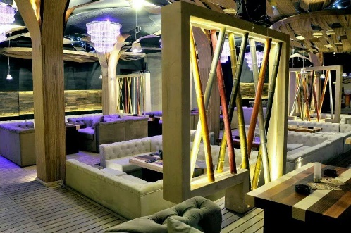
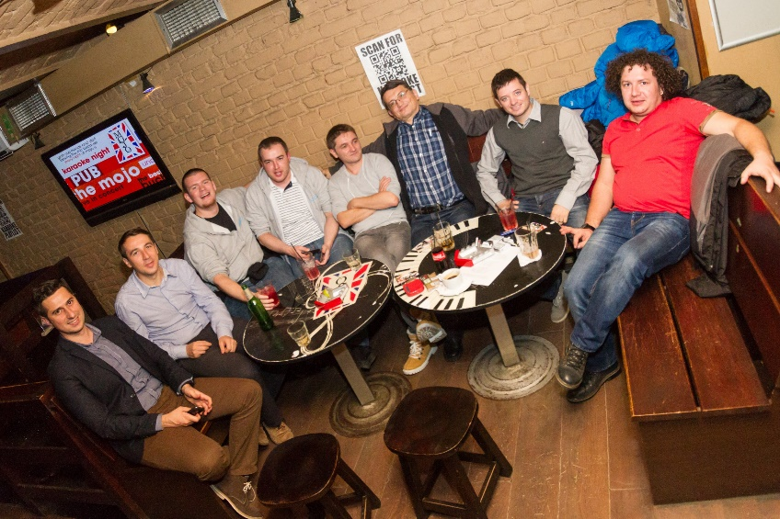
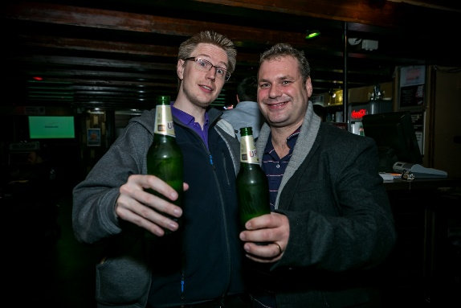
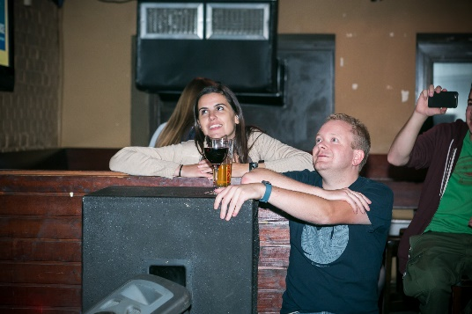
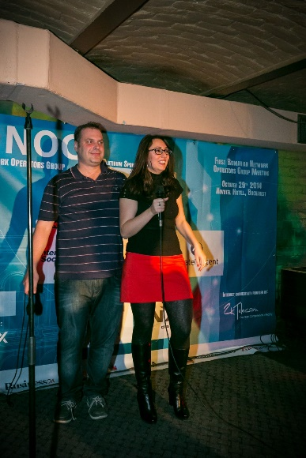
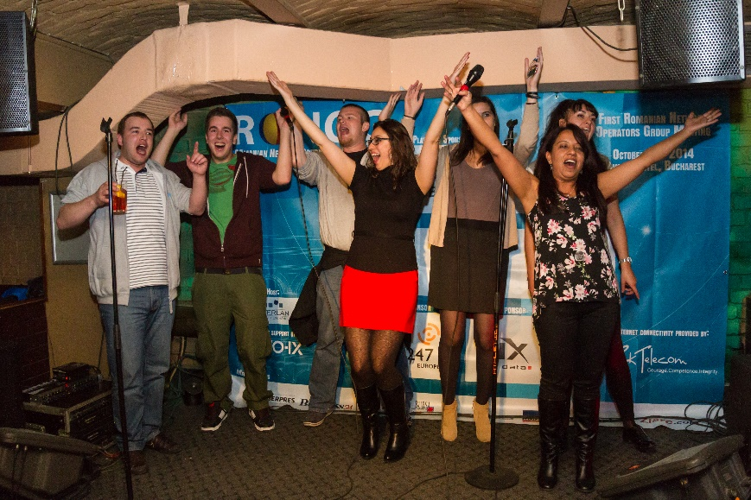
INTERLAN – 10 Years of Peering!
October, 29th, 19:00 – onwards
Maraboo Lounge, 12th Blanari street, Old Town Center

